Slide 1

IMS Starter project
Charles HErrIott
Notes:
Hi, my name is Charlie Herriott. This is my IMS project presentation.

Slide 2
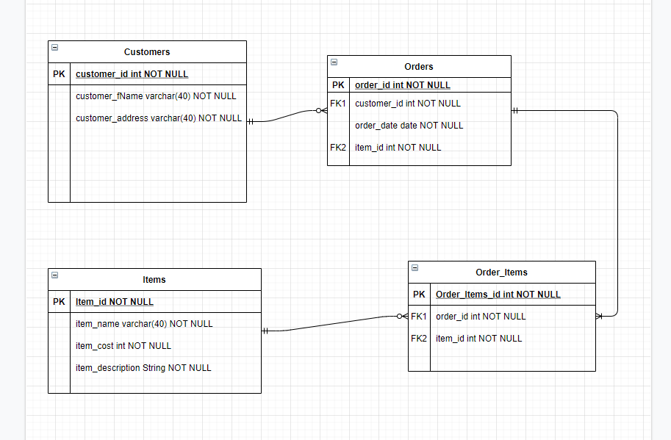
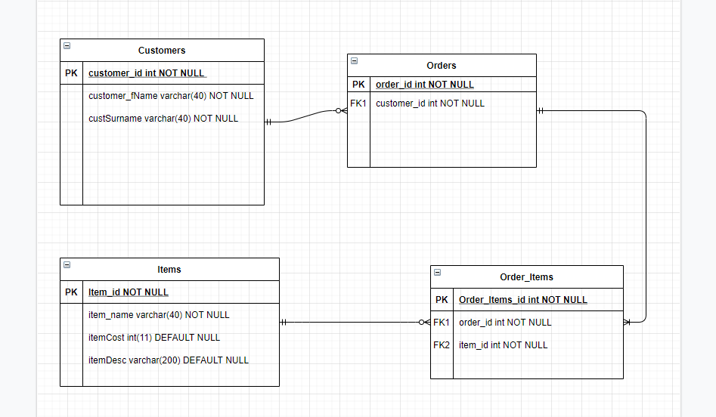
Introduction
Hi, my name is Charlie Herriott.
My approach:
My first step was to create an ERD diagram to describe what I expected the relationships between the database tables to be.
Notes:
When considering how I would approach progressing with the project, my first step was to create Entity Relationship Diagram which would depict the relationships and layouts of the database tables.
This also describes the Key values present within each table, the data types and constraints applied to each value or column.

Slide 3
I considered the structure in which I would approach the project. This meant including Jira and GitHub in my work approach. I adhered to this flow:
I create a user story which describes the end goal and reason behind it
I implemented functionality to complete this task
I then committed the implementation through a feature branch into my GitHub repository
Notes:
I then went on to considering how I would structure the project development moving forward.
This meant creating a workflow to adhere to.
I considered the key elements of the project and created a simple process flow that I would apply to each new implementation.
For example,
Adding items to the system.
I created a user story, describing who would use it, what it would do, and why it would be done
I then moved onto working on the actual code implementation.
I then added, committed and pushed my changes to GitHub.

Slide 4
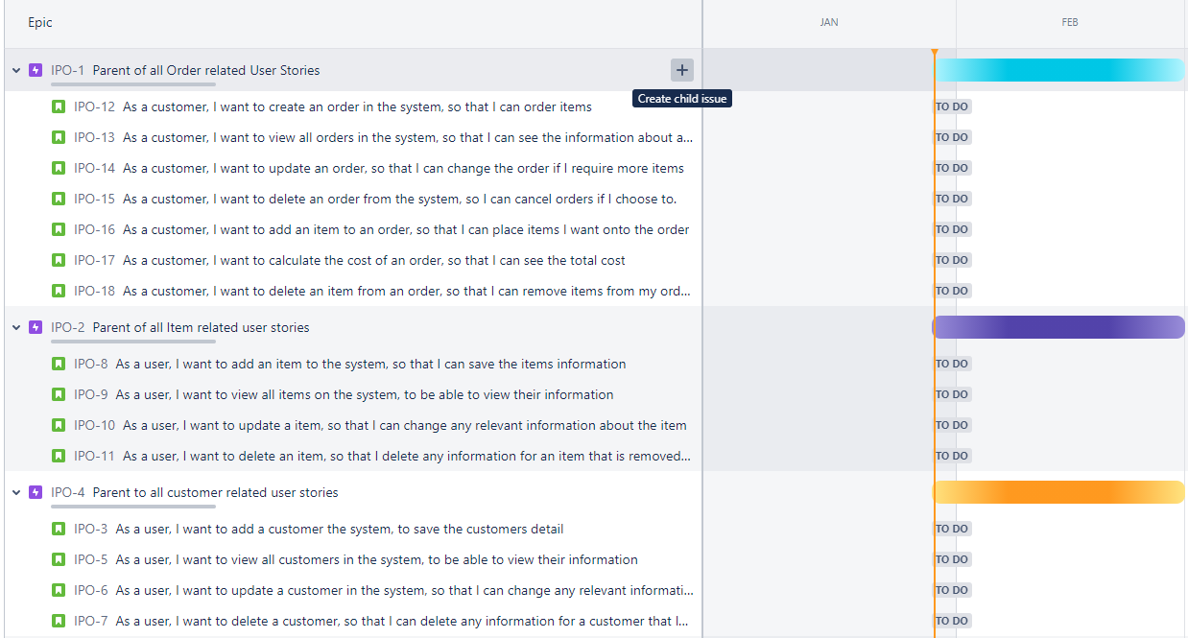
Jira
Jira is made up of Epics, User Stories, Tasks and various values/descriptions that can be applied
Notes:
This is a screenshot of the first draft of my Jira board where I have added user stories to their relevant epics.
This was used to map out the base functionality that I wanted to implement into the program, along with non-code related tasks. For example, creating a risk assessment.

Slide 5
Breaking down the code
My first step was break down the specification into smaller logical steps.
For example, ‘Add a Item to the system’. I took this requirement and broke it down into the steps that I would take to accomplish this task.
I would need to be able to: create an object in Java, pass that object through an SQL query, add it to the database and then read the row back from the database, including the primary key.
Notes:
When I was considering how to approach developing the code for a requirement, I broke each task down into smaller tasks, figuring out how the logical flow would work.
So, back to the Add Item example. The first thing that I need to be able to do is take in a user input.
After capturing the input, this was passed through the ItemController create function.
Which was then passed through to the ItemDAO, which executed the relevant SQL query.
Which then returned a created Item Object with the respective values applied.

Slide 6
Consultant journey
Technologies:
Eclipse/ Java
Jira
GitHub
SonarQube
Junit
Mockito
SQL
Research
Notes:
Over the next few slides I am going to cover the technologies that I have learnt over previous weeks, and how I used them within the scope of my project.

Slide 7
Eclipse / JAva
Eclipse is an integrated development environment used in computer programming. It contains a base workspace and an extensible plug-in system for customising the environment.
Notes:
Eclipse has been the heart of this project, where all of my code development and implementation of my project planning has come to life.
Java is the language used to develop this project, and there are many techniques and principles that I have recently learnt that I have applied to the project.

Slide 8
Object oriented programming principles
I have attempted to stick to the OOP principles throughout my project, making understandable, clean and efficient code under this structure.
Encapsulation
Inheritance
Polymorphism
Abstraction
Notes:
The OOP principles are a very powerful tool that can be used, to create elegant and efficient code. They are applied to many languages, including Java. I have attempted to stick to the OOP principles throughout my project, making understandable, clean and efficient code under this structure.

Slide 9
Solid prinicples
S – single responsibility
O – open for extension, closed for modification
L – liskov substitution
I – interface segregation
D – dependency inversion
Notes:
I have attempted to apply SOLID principles throughout the entire development process of this project.
Each class present within my project has singular responsibility.
Each method within each class, is independent and does not rely on any other method, meaning that they could be used within a different class by another developer.
Liskov substation couldn’t really be applied as there is no inheritance in this project, only implementations.

Slide 10

JiRA
Jira is a proprietary issue tracking product developed by Atlassian that allows bug tracking and agile project management.
Notes:
Jira has been an exceptionally powerful tool that has been utilised within this project.
It has helped to map out the development process, how to maintain tasks and priorities.

Slide 11
Jira uses
Jira can be used simply, or in much more detail. For example, a basic user story allows for a brief description of the task.
Jira story points allow for effort-required values to applied to each task.
Jira priority can be used to denote the urgency of the task.
Descriptions can be added to communicate between members of the team, and to highlight issues.
Smart commits when integrated with GitHub
Notes:
I have attempted to utilise the full power of Jira, by applying subtasks, story points, MoSCoW prioritisation, utilising smart commits, creating and completing sprints.

Slide 12
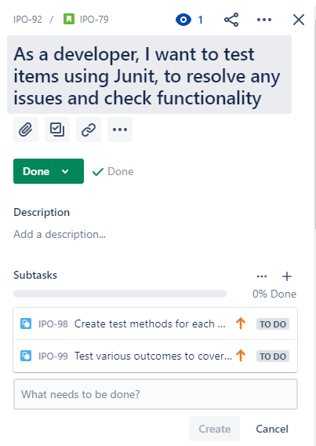
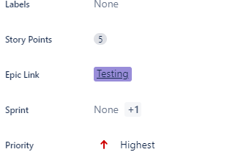
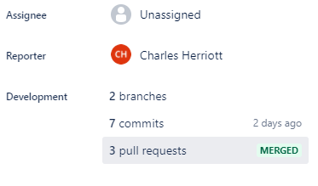
JIRA User stories
Notes:
The screenshot on the left shows the user story with the relevant subtasks.
The screenshot in the middle shows the epic link, the story points and the priority
The screenshot on the right shows the smart commits that have been used with the integration of github and jira

Slide 13
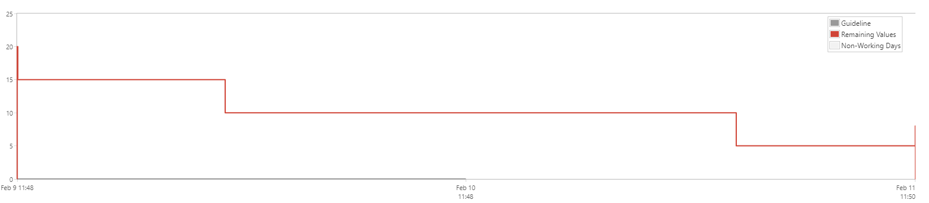
Sprint report
Notes:
This is a sprint report showing the story points over time.

Slide 14
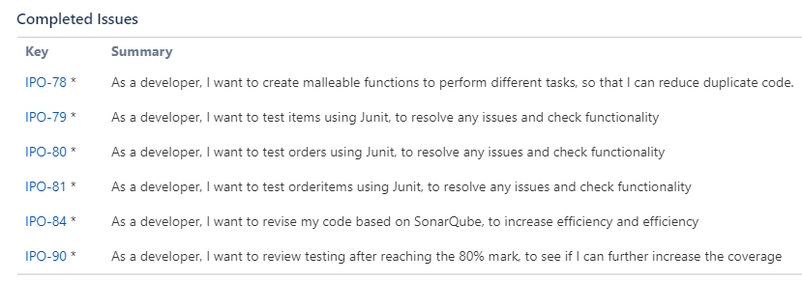
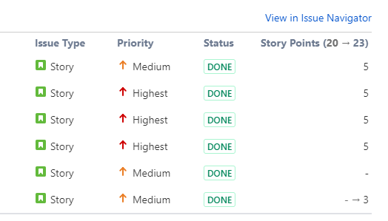
Sprint status report
Notes:
This is a sprint status report, showing the completed or completed stories and their relevant assignments

Slide 15

Github
GitHub is a distributed version-control system for tracking changes in any set of files.
Notes:
GitHub has been an integral component to this project, allowing for easily maintainable version control, and files tracking.
I have used GitHub regularly throughout the project, and the entire flow of the project should be visible throughout the commit history graph.

Slide 16
Github uses
GitHub allows for controlled commits of features through GitBash.
This allows for projects to be worked on in tandem with other developers.
New code can be committed and then merge request can be pulled and reviewed before actually being implemented.
The power of version control really shines when a version rollback is needed, and the previous can be simply pulled from GitHub.
Notes:
I have attempted to utilise the full power of GitHub, making commits at the proper time, in the proper feature branches.
This was particularly useful when ensuring that new implementation was compatible with the master code.
GitHub allows for controlled commits of features through GitBash.
This allows for projects to be worked on in tandem with other developers.
The power of version control really shines when a version rollback is needed, and the previous can be simply pulled from GitHub.

Slide 17
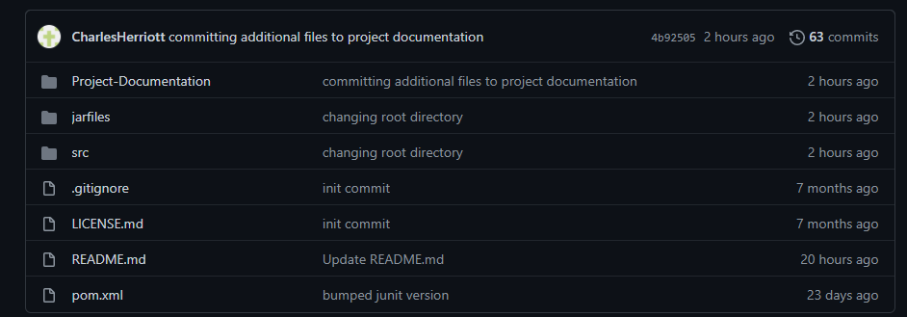
Github repository
Notes:
This screenshot shows my github repository, which highlights the file structure that been implemented for the project. This allows me to maintain versions of my project documentation as well as my code.

Slide 18

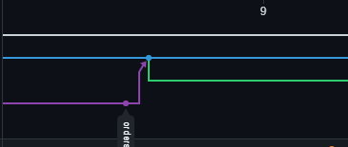
Github commit progression
This was the first commit that I made. Committing some implementation.
w
This commit is from around the middle of the timeline, where I was completing user story tasks and then merging the branches.
First Commit
Commit and then create new branch
Notes:
The first timed I committed, I committed the item feature branch, and then merged that with develop branch.
I then decided I wanted to work more on the item branch so I didn’t delete the branch, and committed and merged again further down the line.
At this time I also created a Jira branch, and I was working on that at the same time.
In the second image, I had finished what I had wanted to do with the orders branch, so I committed and merged. I then created a new branch to work on created some enums to clean up my code.

Slide 19
GitHub Smartcommits
Notes:
Around the middle of my project I started to utilise smart commits

Slide 20
Testing

Slide 21
Demonstration

Slide 22
Sprint review

Slide 23
Sprint retrospective

Slide 24
conclusion

Slide 25
questions

